Slide 1

Review of Probability Concepts
Financial Modeling

Slide 2
Agenda
Probability concepts
Common probability distribution

Slide 3
Probability concepts
Quantitative Investment Analysis
Chapter 4
Other reading material
“Introductory Statistics”, 8th edition, by Neil A. Weiss
ISBN 0-321-39361-9
Or any other introductory statistics textbook

Slide 4
Events, sample and probability
Experiment – process of observation that leads to a single outcome with no predictive certainty
Sample point – most basic outcome of an experiment
Sample space – a listing of all sample points for an experiment
Event: a specific set of sample point (s)

Slide 5

Example: tossing a coin
Experiment: tossing a coin
Sample point: outcome
Head is one sample point
Tail is one sample point
Sample space: all possible outcomes
2 sample points
Head and Tail
Event
Get a head
Get either a head or a tail
In this case, the event is a set of sample points (head or tail)

Slide 6
Defining properties of probability
Probability
Probability is the likelihood (chance) that an event will occur
The probability of any event (E) is a number
Between 0 and 1
0< P(E)< 1
The sum of probabilities of any set of mutually exclusive and exhaustive events equals 1
Mutually exclusive: only one event can occur at a time
In other words, you can not have two mutually exclusive events at the same time
Exhaustive: the events cover all possible outcomes

Slide 7
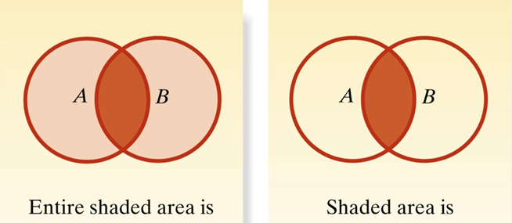
Unions and intersections
Compound event – a composition of two or more events
union: A or B
b. intersection: A and B

Slide 8
Examples
Sample space (1,2,3,4,5,6,7,8,9)
Event A
2,3,4,5
Event B
1,3,4,8,9
Event (A or B): Union of A and B
1,2,3,4,5,8,9
Event (AB): Intersection of And B
3,4

Slide 9
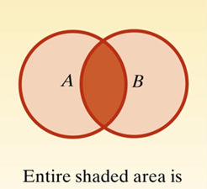
The additive rule
A includes sample points only in A and sample points in AB
B includes sample points only in B and sample points in AB
The sample points in AB are double-counted

Slide 10
An extension to additive rule

Slide 11
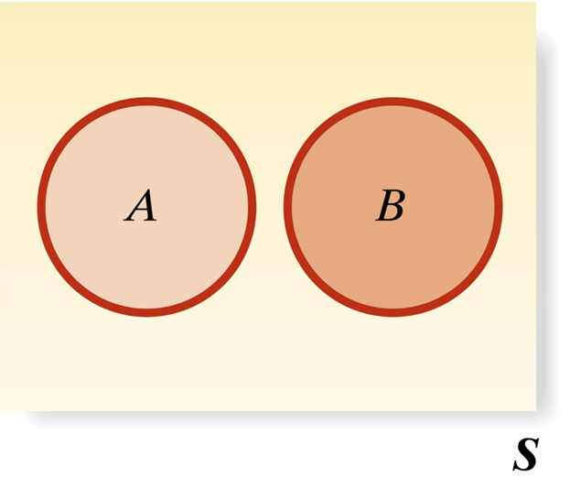
Mutually exclusive events
Events are mutually exclusive if they share no sample point(s)
P(AB)=0

Slide 12
Example: corporate payout policy
Event A: Payout cash
Dividend payment
Note: Assuming dividend payout is the only way for a firm to distribute cash
Do not consider stock repurchase at this moment
Event B: Keep all cash reserve
No cash payment
Events A and B are mutually exclusive
You can not have Events A and B for the same company at the same time

Slide 13
The additive rule and mutually exclusive events
If P(AB)=0
Events A and B are mutually exclusive
We have

Slide 14
Unconditional probability vs. conditional probability
Unconditional probability (marginal probability)
P(A)
The probability of A (it is a straightforward question)
Conditional probability
P(A|B)
The probability of A given B (with additional information)

Slide 15
Examples for unconditional probability
What is the probability for company M to cut dividend in the next fiscal year?
What is the probability for company M to issue equity in the next three years?
What is the probability for company M to have EPS (earnings per share) above $2?

Slide 16
Examples for conditional probability
What is the probability for company M to cut dividend in the next fiscal year
Given that company M cuts dividend in this fiscal year
Given that company M initiates dividend payment in this fiscal year
What is the probability for company M to issue equity in the next year
Given that company M issues bond in this year
Given that company M issues equity in this year

Slide 17
Conditional probability
Conditional probability – the probability that event A occurs given that event B occurs
Conditional probability works with a reduced sample space, and this reduced sample space contains B and AB
A
AB
B
S

Slide 18
Numerical examples
Define events
Event A
M cuts dividend in this fiscal year
Event B
M cuts dividend in the next fiscal year
Information we have
P[M cuts dividend in this fiscal year(A)]=0.40
P[M cuts dividend in this fiscal year and cuts dividend in next fiscal year(AB)]=0.10
What is
The answer

Slide 19
The multiplicative rule and joint probability
Joint probability
P(AB)
The multiplicative rule
Question
P(ABC)=?

Slide 20
Example: joint probability
Define events
Event A: Company M is overvalued
Event B: Company M issues equity
Information we have
Market timing hypothesis suggests that companies tend to issue equity when they are overvalued
What is P(AB)?
The answer

Slide 21
Independent events vs. dependent events
Two events A and B are independent
If and only if
P(A|B)=P(A)
Or P(B|A)=P(B)
In other words, the occurrence of event A does not affect the probability of the occurrence of event B
Two events A and B are dependent
If events A and B are not independent, then they are dependent

Slide 22
The multiplicative rule and independent events
Events A and B are independent if the occurrence of one does not alter the probability of the occurrence of the other
If A and B are independent events

Slide 23

Complementary events
For Event S
S^{C} (the complement of Event S) includes all sample points that do not belong to Event S
S
It is easy to see that S and S^{c} are mutually exclusive
S^{C}

Slide 24
Total probability rule
In reality, P(A) is very difficult to calculate, but it is relatively easier to get information about P(S) and P(A|S)
Where S₁,S₂,…S_{n} are mutually exclusive and exhaustive events

Slide 25
Example: capital gap
Question: What is the probability for company M to have a capital gap?
Define events
Event A: Company M has capital gap
Event S: Company M pays dividend
Event S^{c}: Company M does not pay dividend
Probability (Company M has capital gap)=0.15+0.30=0.45

Slide 26
Bayes’ formula
Bayes’ Formula updates the odds of an event given a piece of helpful information

Slide 27


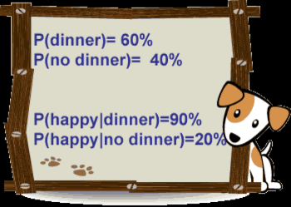

Example: http://www.bionicturtle.com/learn/article/fido_helps_explain_bayes_formula/
Question: What is the probability that Fido (the dog’s name) gets a bone given that Fido is happy?

Slide 28
Principle of counting
Multiplication rule of counting
Figure out all logical possibilities
(n₁)(n₂)(n₃)…(n_{k})
n_{k} stands for the possible ways to complete the task in the kth step
n!=n(n-1)(n-2)(n-3)…1
Reads, n factorial

Slide 29
Example 1: classify stocks
(n₁)(n₂)(n₃)…(n_{k})
Three steps to categorize publicly traded stocks
1st step
nation (US firms vs. non-US firms)
tech-attribute (High-tech firms vs. non-tech firms)
2nd step
market of listing (NYSE vs. NASDAQ)
VC involvement (VC-backed vs. non-VC-backed)
3rd step
profitability
How many possible ways to classify stocks
(n₁)(n₂)(n₃)=2*2*1=4
The list of all possible ways to finish the task
Nation-market of listing-profitability
Nation-VC involvement-profitability
Tech-attribute-market of listing-profitability
Tech-attribute-VC involvement-profitability

Slide 30
Example 2: selecting analysts and industries
Objective: let three analysts choose their industry focus
Three analysts (A, B and C)
Three industry (mining, transportation and retail)
A (3) B (2) C (1) 3*2*1=6
Mining trans retail
Mining retail trans
Trans mining retail
Trans retail mining
Retail mining trans
Retail trans mining

Slide 31
Labeling problem (order does not matter)
Multinomial formula (General formula)
Combination formula (Binomial formula)

Slide 32
Illustration 1: multinomial formula
There are n! ways in total to choose n objects
But, there are duplications
Calculate the number of duplications
For n₁ objects
Order does not matter
The number of duplications is n₁!
For n_{k} objects
Order does not matter
The number of duplications is n_{k}!

Slide 33
Chapter 4, pp. 167: simplified example
Objective
Choose 10 stocks
3 out of 10 as high risk stocks
3 out of 10 as medium risk stocks
the rest 4 out of 10 as low risk stocks

Slide 34
High risk: 3
Medium risk: 3
low risk: 4
A
B
C
1 2 3
1 3 2
2 1 3
2 3 1
3 2 1
3 1 2
1st step
Duplication: 6
2nd step
Duplication: 6
3rd step
Duplication: 24

Slide 35
Illustration 2: combination formula
Objective
choose 3 out of 10 stocks
label them as high risk stocks
Implicitly, we can group the rest 7 out of 10 as non-high risk stocks
Even though this is not part of the problem

Slide 36
High risk: 3 out of 10
Non-high risk: 7 out of 10
A
B
C
1, 2, 3
1, 3, 2
2, 1, 3
2, 3, 1
3, 2, 1
3, 1, 2
1st step
Duplication: 3!
2nd step
Duplication: 7!

Slide 37
Let’s go back to Illustration 1
Objective is the same
3 out of 10 as high risk stocks
3 out of 10 as medium risk stocks
the rest 4 out of 10 as low risk stocks
Procedure is different
1st step: choose 3 out 10 as high risk
2nd step: choose 3 out of 7 as medium risk
3rd step: mark the rest 4 as low risk
Note: 0!=1

Slide 38
Labeling problem (order matters)
Choose r objects from a total of n objects, when the order in which the r objects are listed does matter
Permutation formula

Slide 39
Illustration
For r objects
Order matters
For (n-r) objects
order does not matter
For (n-r) objects
The number of duplications is (n-r)!

Slide 40
Illustration (cont’d)
1st step: choose r out of n
Order does not matter
2nd step: order the r objects
r!
1st step
2nd step

Slide 41
Expected value
Variance
Covariance
Correlation

Slide 42
Summation notation
Used to simplify summation instructions
Each observation in a data set is identified by a subscript
x₁, x₂, x₃, x₄, x₅, …. x_{n}
Notation used to sum the above numbers together is

Slide 43
Expected value of a random variable
Probability weighted average of the possible outcomes of the random variable
The expected value of X is E(X)

Slide 44
Example 4-8 BankCorp’s Earnings per share (EPS)

Slide 45
Variance
Variance of a random variable is the expected value of squared deviation from the random variable’s expected value

Slide 46
Standard deviation
Positive square root of variance

Slide 47
Example: Variance and standard deviation
E(EPS)=$2.3405
σ²(EPS)=0.0387475
σ=0.0387785^{1/2}=$0.0196939

Slide 48
Properties of expected value
E(w_{i})=w_{i}
w_{i} is a constant
E(w_{i}R_{i})=w_{i}E(R_{i})
w_{i} is a constant
E(w₁R₁+w₂R₂+…+w_{n}R_{n})=w₁E(R₁)+w₂E(R₂)+…+w_{n}E(Rn)

Slide 49
Covariance
For two random variables, R_{i} and R_{j}
Cov (R_{i,}R_{j})
σ_{ij}

Slide 50
Correlation
For two random variables, R_{i} and R_{j}
ρ(R_{i},R_{j})
Corr(R_{i},R_{j})
ρ_{ij}

Slide 51
Properties of correlation
A Correlation of 0
indicate an absence of any linear relationship between X and Y
A correlation of 1
Indicate a perfect positive linear relationship
A correlation of -1
Indicate a perfect negative linear relationship
Question: correlation and independency: are they the same?

Slide 52
Variance of X+Y

Slide 53
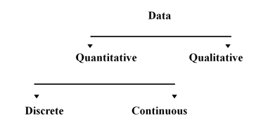
Common probability distribution
Binomial distribution
Uniform distribution
Normal distribution

Slide 54
Random variables
Random variable
Variable that takes on numerical values associated with random outcomes of an experiment
Only one numerical value is assigned to each sample point
Two types of random variable
Discrete
Continuous

Slide 55
Random variables (cont’d)
Discrete random variable
Can take on a limited number of values
Can take on an unlimited number of outcomes
Has to be countable
Continuous random variable
Can take on values corresponding to any of the points contained in one or more intervals
Outcomes cannot be counted

Slide 56
Probability function
Specify the probability that the random variable takes on a specific value
P(X=x) is the probability that a random variable X takes on the value of x
For continuous random variables
Probability function is denoted as
f(x): the probability density function

Slide 57
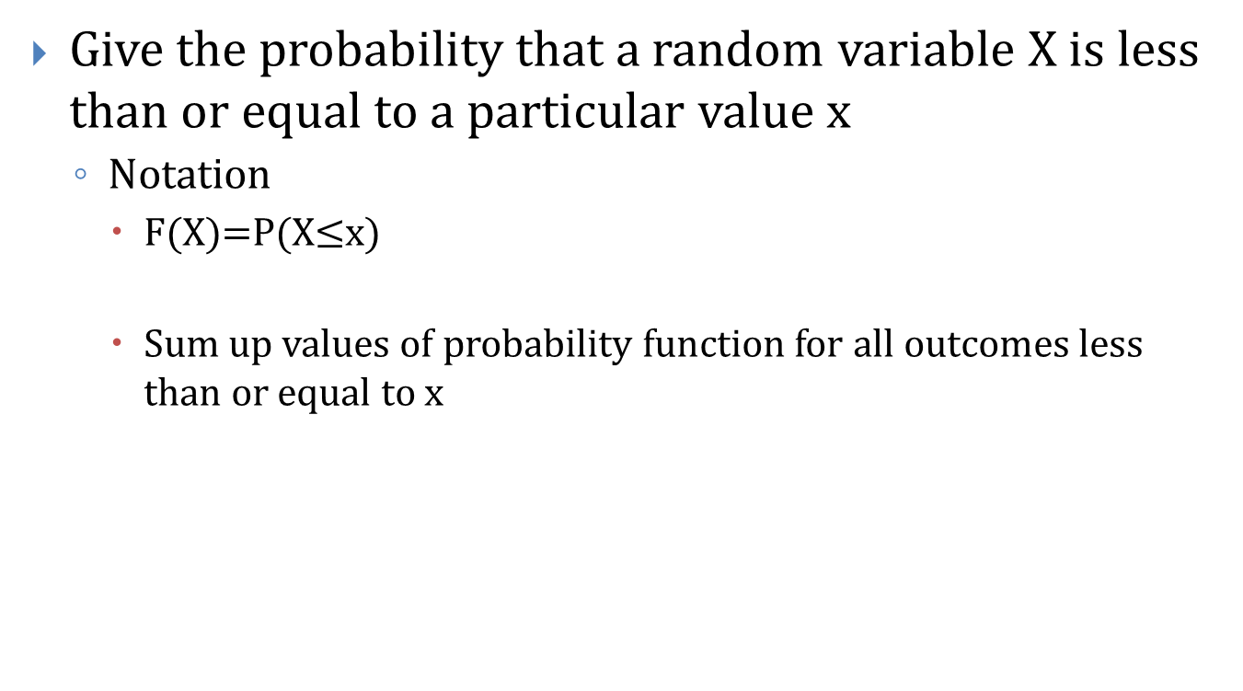
Cumulative distribution function
Give the probability that a random variable X is less than or equal to a particular value x
Notation
F(X)=P(X$≤$x)
Sum up values of probability function for all outcomes less than or equal to x

Slide 58
Probability distributions for discrete random variables
Probability Distribution of a discrete random variable is a
Graph
Table
Formula
That specifies the probability associated with each possible value the random variable can assume

Slide 59
Probability distributions for discrete random variables
Two requirements that must be satisfied
For all values of x
Where the summation of p(x) is over all possible values of x

Slide 60
Probability distribution

Slide 61
Cumulative probability function
0, x<2.00
0.15, 2.00<x<2.20
0.60, 2.20<x<2.45
0.84, 2.45<x<2.60
1, 2.60<x
F(X)=
1
F(x)
0.84
0.60
0.15
x
2
2.2
2.45
2.60

Slide 62
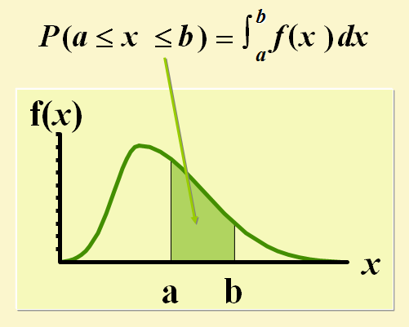
Continuous random variable probability

Slide 63
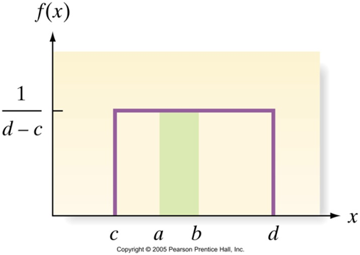
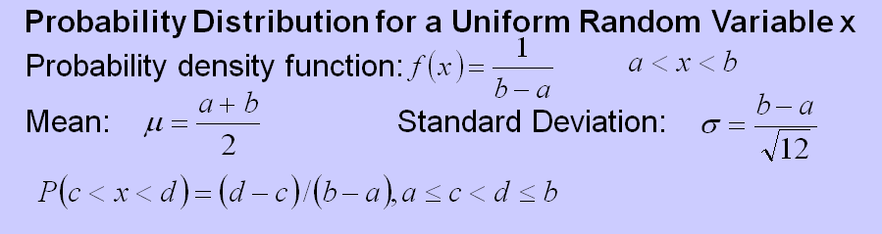
The uniform distribution
Uniform Probability Distribution:
Distribution resulting when a continuous random variable is evenly distributed over a particular interval
b-a
a c d b

Slide 64
Cumulative probability function
0, for x<a
(x-a)/(b-a), for a<x<b
1, for x>b
F(X)
F(X)
1
a
b
x

Slide 65
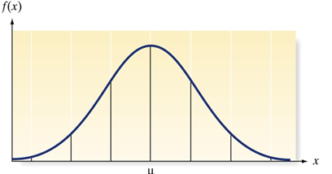
The normal distribution
A normal random variable has a probability distribution called a normal distribution
Bell-shaped curve
Symmetrical about its mean μ
Spread determined by the value of it’s standard deviation σ

Slide 66
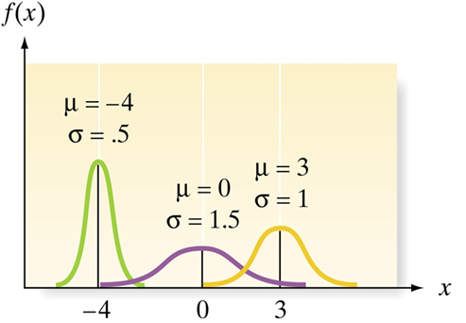
The normal distribution (cont’d)
The mean and standard deviation affect the flatness and center of the curve, but not the basic shape
A good approximation for returns

Slide 67
Normal probability density function

Slide 68
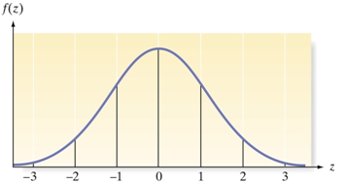
The normal distribution
Probabilities associated with values or ranges of a random variable correspond to areas under the normal curve
Calculating probabilities can be simplified by working with a Standard Normal Distribution
A Standard Normal Distribution is
A normal distribution with μ =0 and σ =1

Slide 69
Lognormal distribution
A random variable Y follows a lognormal distribution if its natural logarithm, lnY, is normally distributed
In other word
If the natural logarithm of random variable Y, lnY, is normally distributed, then Y follows a lognormal distribution
A simple way to remember
The log is normal distribution

Slide 70
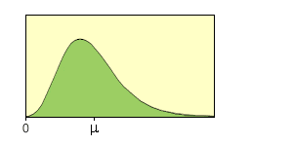
Lognormal distribution
Bounded by 0
Skew to the right (long tail on the right side)
Very useful to describe price distribution

Slide 71
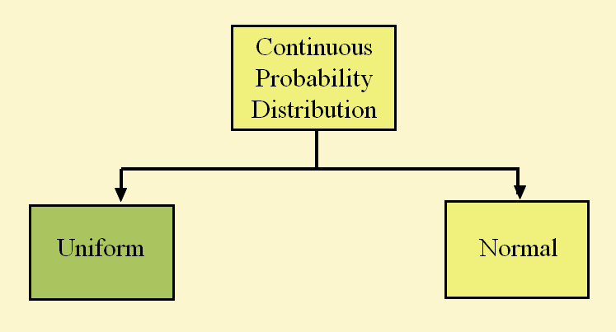
Continuous probability distributions
Lognormal

Slide 72
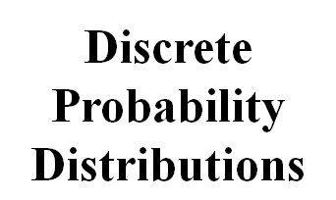


The Discrete Probability Distributions

Slide 73
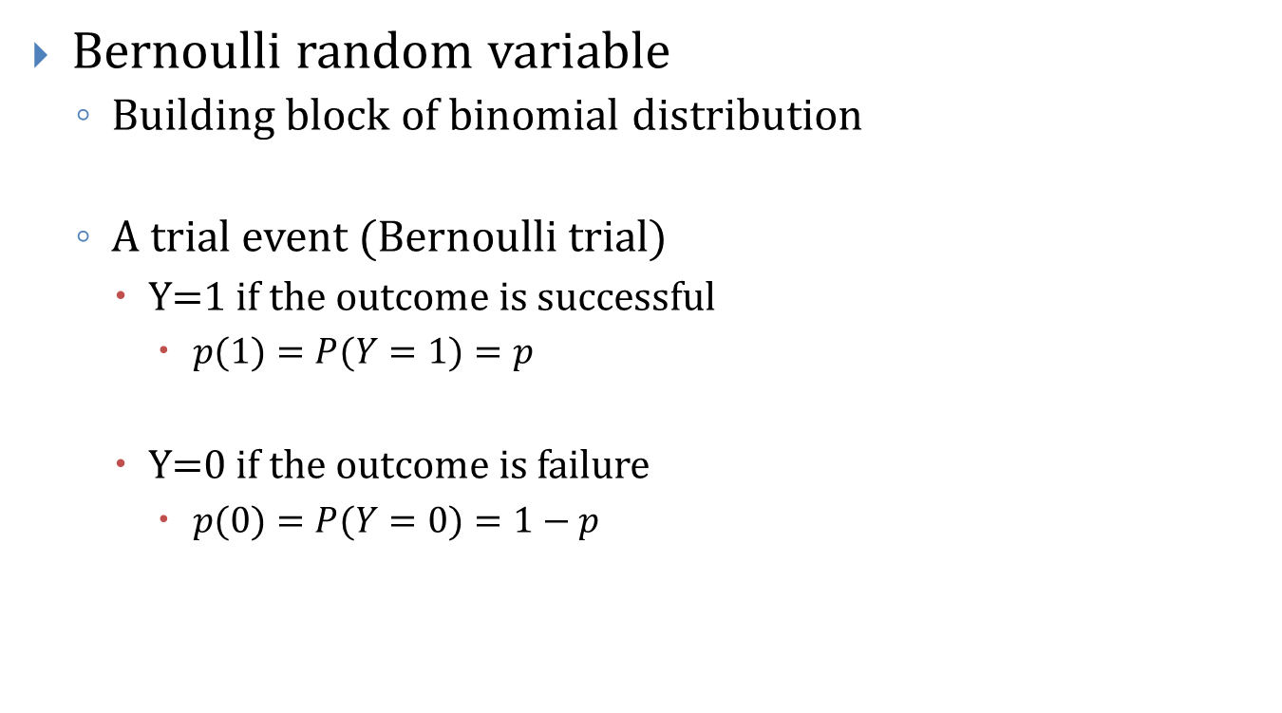
Bernoulli trial and Bernoulli random variable
Bernoulli random variable
Building block of binomial distribution
A trial event (Bernoulli trial)
Y=1 if the outcome is successful
$p(1)=P(Y=1)=p$
Y=0 if the outcome is failure
$p(0)=P(Y=0)=1−p$

Slide 74

The Bernoulli random variable
Mean
$p$
Variance
$p(1−p)$

Slide 75
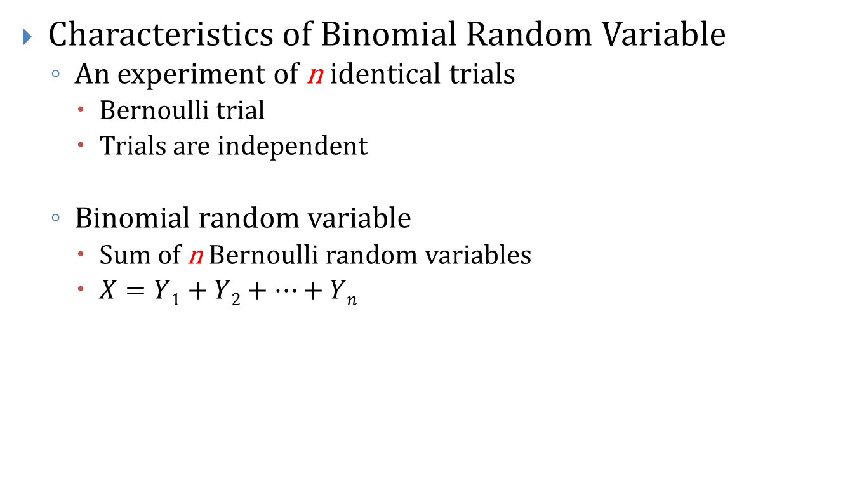
The binomial distribution
Characteristics of Binomial Random Variable
An experiment of n identical trials
Bernoulli trial
Trials are independent
Binomial random variable
Sum of n Bernoulli random variables
$X=Y1+Y2+…+Yn$

Slide 76
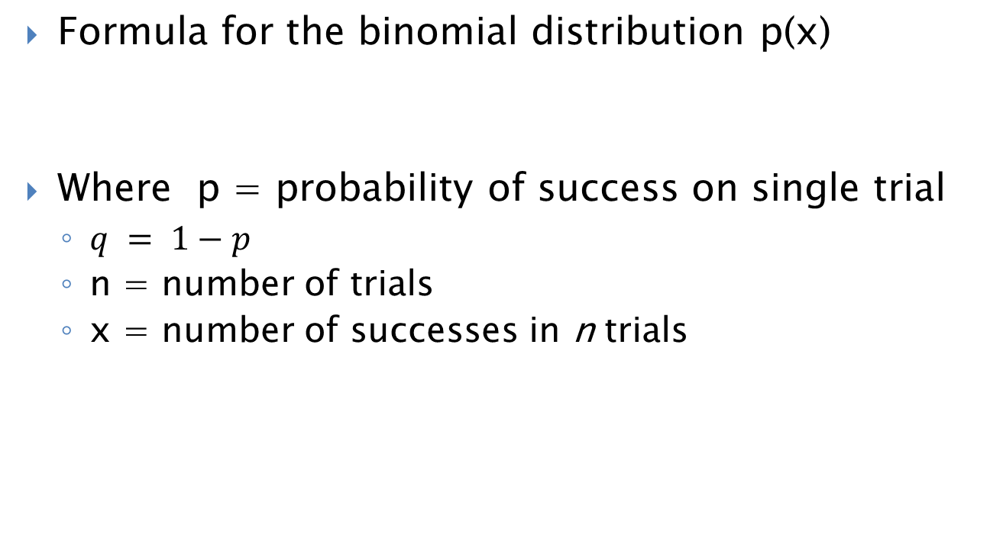
The binomial distribution:
Formula for the binomial distribution p(x)
Where p = probability of success on single trial
$q = 1−p$
n = number of trials
x = number of successes in n trials

Slide 77
The binomial distribution
Mean
np
Variance
np(1-p)

Slide 78
Symmetry
Binomial distribution is
Symmetric
When the probability of success on a trial is 0.50
Asymmetric or skewed
When the probability of success on a trial is not 0.50

Slide 79
Example: 5-6 defaults in a bond portfolio
25 bonds in a portfolio
Estimated default likelihood for each bond is 10.7%
Q1: what is the number of defaults in next year
Q2: estimated the standard deviation of defaults in next year
Q3: What is the assumption here? Is it reasonable?

